Slide 1
Kentucky Nutrient Management Plan
A Brief Overview for Kentucky State Cost Share Funding

Slide 2
WHO Needs one?
The Kentucky Agriculture Water Quality Act states that landowners with 10 or more acres who land-apply plant-available nutrients or who export manure must develop and implement a Kentucky Nutrient Management Plan (KYNMP) as part of their Agriculture Water Quality Plan.
In addition, the Kentucky State Cost Share Program requires that if the installation of a heavy use area is to be used for livestock winter feeding purposes, then a KYNMP must be developed for that operation. This includes practice codes 561 A,B,C,D,G within the Pastureland BMP Category.

Slide 3
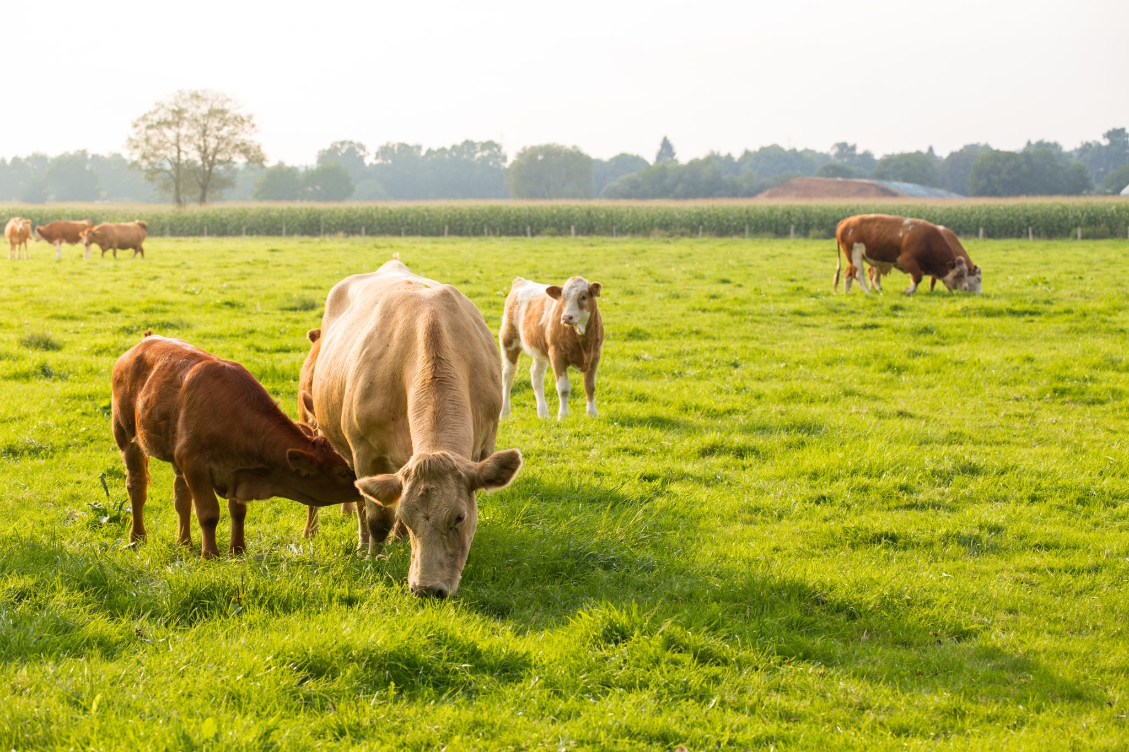
What is a Nutrient Management Plan?
There are 3 types of nutrient management plans:
KYNMP is the plan of which we are learning in this presentation, required as noted on previous slide.
NMP is a more detailed plan, normally developed by a technical service provider, and typically deals with cropland fertilizer application. NRCS Practice Code 590.
CNMP is a comprehensive nutrient management plan, and is the most involved of the three types of plans. It is developed by a technical service provider, and is typical of animal feeding operations. This plan may be required by NRCS specs if providing technical assistance on a State Cost Share application. NRCS Practice Code 102.
Nutrients are constantly cycling through farms. Nutrients come onto a farm in the form of feed, commercial fertilizers, manure, or compost, and they leave the farm with harvested crops, sold livestock, and off-site disposal of manure and other waste. Sometimes nutrients are even lost to the air, soil, or water. Nutrient management allows farmers to use nutrients (specifically nitrogen, phosphorus, and potassium) wisely for optimal economic benefit with minimal impact on the environment.
Approximately 80 percent of nutrients fed to an animal passes through the gut and into its manure. If managed correctly, the nutrients and organic matter in this manure can be recycled to produce crops and save producers money. If managed incorrectly, manure can contribute to nonpoint source pollution that threatens water quality. One practice that reduces the impact of agriculture on natural resources is nutrient management planning, which involves monitoring and recording all aspects of soil fertility, manure sampling, and crop production so that air, soil, and water resources are not compromised. Thus, a KYNMP is essentially a mass balance of all incoming and outgoing nutrients on a farming operation.

Slide 4
Who can create a Kynmp?
There is no qualification to be able to complete a KYNMP. Anyone that has the proper information for the operation and is able to use a computer and fill data into a spreadsheet can complete a plan. If assistance is needed, local conservation district staff, UK Extension staff, or Ky. Division of Conservation staff may offer assistance.
The University of Kentucky Extension Service webpage on nutrient management planning provides information, training, examples and the KYNMP management calculator tool to create a KYNMP for any operation. The link to the webpage is: https://www.uky.edu/bae/awqp-nmp

Slide 5
Calibration of a manure spreader at a UK Extension
Virtual field day in Simpson County, 2020.

Slide 6
What do I need to get started on a plan?
Begin by getting a map of your farming operation.
You can acquire a map using the internet, through your local conservation district, USDA service center, or County Property Valuation Administrator.
Draw and name each of the fields where you are pasturing livestock or growing crops.
Collect soil samples for each of the farm fields that you marked and named on the farm map.
Collect a sample from stockpiled manure that you plan to land apply using the recommendations provided in the KYNMP.
Provide the results of the soil and manure samples to your local Conservation District or whoever will be developing your KYNMP.

Slide 7
A typical farming operation’s nutrient management plan should contain:
A farm map that shows the field boundaries and some sort of naming/numbering system for proper field identification.
Soil test results for each field.
Nutrient sample results for each type of livestock manure being land applied.
Calculations that show the amount of manure that should be applied to each field.
A written description of how to manage your on-farm nutrients in relation to cropping cycles.
Nutrient Management Plans may also contain recommendations for additional farm facilities such as covered manure stack pads or barn yard guttering to reduce storm water into livestock feeding areas and lagoons.
Winter Heavy Use Feeding Area (561A)
Simpson County, KY

Slide 8
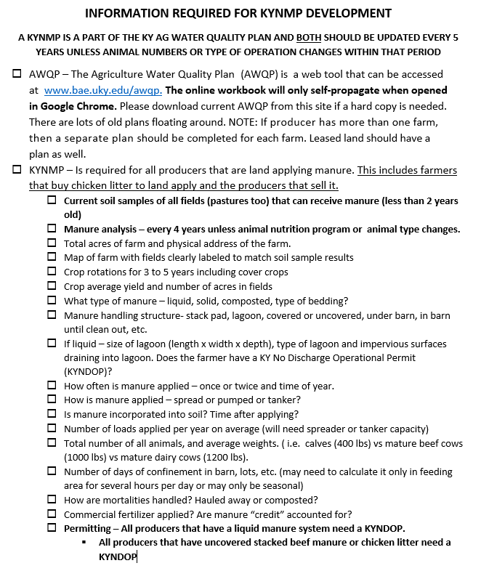
Standard Field Checklist for KYNMP Development

Slide 9
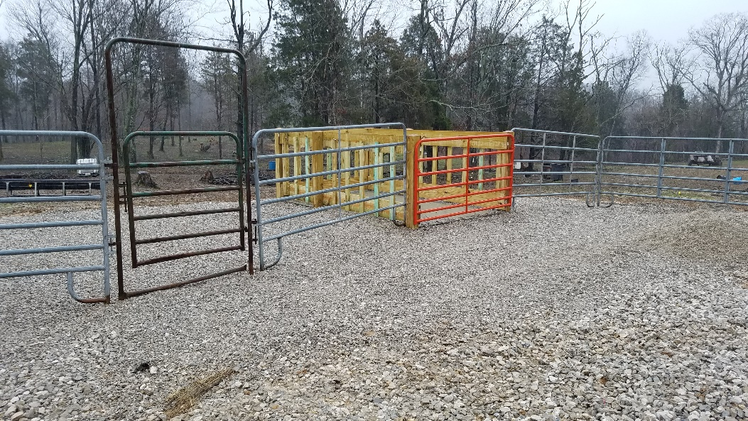
The four (4) R’s of Nutrient management
A typical Kentucky winter feed area
Right Amount (Rate)
Right Source
Right Placement (application method)
Right Timing of commercial fertilizers, manure, soil amendments, and organic by-products to agricultural landscapes as a source of plant nutrients while protection local air, soil, and water quality.
A better option to control erosion and manure. SCS Practice Code 561G – Fence Line Feeder

Slide 10
What are the benefits in following a nutrient management plan?
Producers gain information about their farming operation through the
development and use of a nutrient management plan. They gain more
knowledge about their soil nutrient levels and the nutrients needed to produce a crop. They gain a better understanding about when and where to apply livestock manure, commercial fertilizers, or other soil amendments. They have a better understanding of which farm fields need additional nutrients and which do not. Ultimately their farming operation is more productive and sustainable with increased crop yield, soil organic matter, and improved soil moisture.
The most straightforward benefit of nutrient management planning for a
producer is saving money. Applying only the nutrients that are necessary to produce a crop reduces input costs, and producers get increased crop yields by providing adequate nutrients necessary to produce that crop.

Slide 11
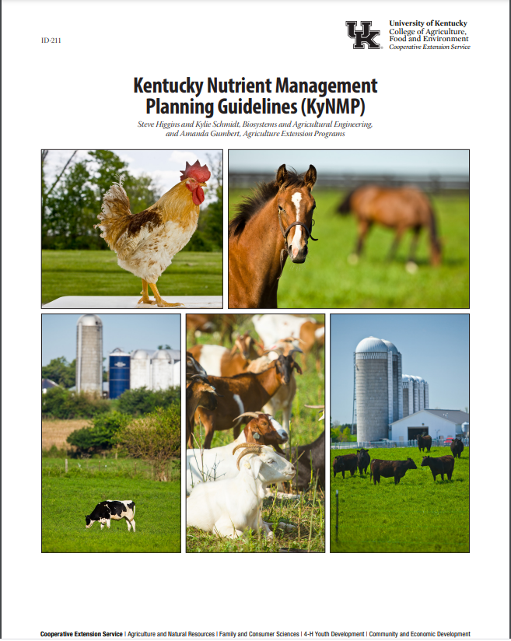
Best resource for kyNMp planning
UK Extension Publication ID-211 is a comprehensive, step-by-step guide to the planning, considerations, and completion of a KYNMP.
This document outlines the needed information, the workbook and creating a plan, the science, and implementation of the plan when complete.
This document may be found at the following link: http://www2.ca.uky.edu/agcomm/pubs/ID/ID211/ID211.pdf

Slide 12
If you have any questions or need assistance, please contact your local Ky. Division of Conservation field representative or:
Jay Nelson, KDOC: jay.nelson@ky.gov
or
Jim Roe, KDOC: james.roe@ky.gov

